Slide 1
Quantum Computing
Dr. William Hutton
Washington State University

Slide 2
Quantum Computing Overview
Types of Algorithmic Complexity
A simple PKI example
Classical factoring algorithms
Quantum theory and quantum computers
Peter Shor’s algorithm

Slide 3
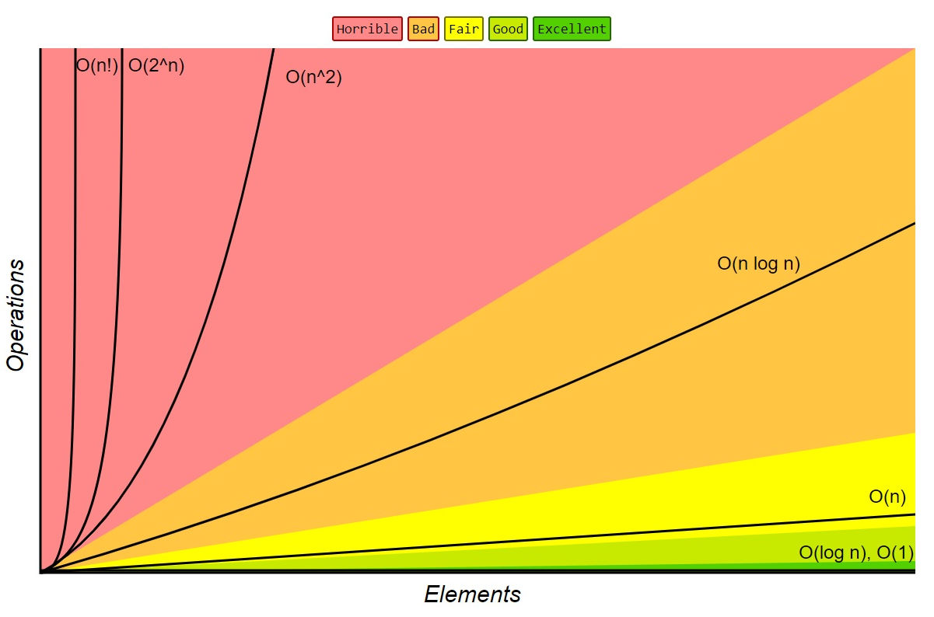
Algorithmic complexity
Time
Constant, Logarithmic, Log-squared, Linear, Quadratic, Cubic, Exponential (Big-Oh)
Space
TM model
Savitch’s theorem
Non-deterministic TM
f(n) space
Deterministic TM
f²(n) space
Notes:
An algorithm that solves a problem but requires a year is of little use. Typically size of input ‘n’, is the main consideration, then looping, recursion, or how many times the algorithm needs to touch the data.
Stadium example of exponential growth. 1 drop of water, water doubles every minute. 43 minutes stadium is half full, 44 minutes it is overflowing. Danger is in the top seats. (https://www.dcscience.net/2020/03/23/exponential-growth-is-terrifying/) Also 2008 DVD—I forgot the name, need to watch it again.

Slide 4
A PKE Example, Numbers
Prime | Non-Prime | Non-Relatively Prime |  | Relatively Prime
17 | 24 | 39 | 21 | 39 | 25
17 | 24 | 39 | 21 | 39 | 25
1 | 12 | 13 | 7 | 13 | 5
 | 8 | 3 | 3 | 3 | 1
 | 6 | 1 | 1 | 1
 | 4
 | 3
 | 2
 | 1
Notes:
Source: Strategic Infrastructure Security (pg. 28)

Slide 5
A PKE Example, Encryption/Decryption
Bob’s Public Key
Alice’s Public Key
Alice’s computer (private key)
Bob’s computer (private key)
DH Encryption
Ciphertext
DH Decryption
Plaintext
Plaintext
Notes:
Important! The public/private key pairs are used to derive a symmetric key using Diffe-Hellman (and Ralph Merkle) symmetric key, which is used to encrypt on Alice’s computer, and decrypt using the same derived key on Bob’s computer.

Slide 6
A PKE Example, Encryption/Decryption
Bob’s Public Key (6)
Alice’s Public Key (8)
Alice (Private key = 23)
Bob (Private key = 29)
p = 11
g = 2
6²³ mod 11 = 7
Ciphertext
8²⁹ mod 11 = 7
Plaintext
Plaintext
Notes:
p = a prime number
g = ”generator” (an integer < p that can generate 1 to p-1 when multiplied by itself a given number of times.)
Both can derive the symmetric key, “7” using a combination of their private key and the other’s public key.
Computationally inexpensive, but a one-way function. Like a 3,000 page dictionary: easy to find the definition given a word, but hard to find the word given a definition (w/o brute force effort).
Source: Strategic Infrastructure Security (pg. 55)

Slide 7
RSA Encryption Algorithm
Take two large (at least 1,024 bits; 309 digits) prime numbers, p and q
Calculate the product pq = n
Choose a number e such that:
e < n
e is relatively prime to (p-1)(q-1) [Euclid]
There are no common factors for e, (p-1) or (q-1)
Calculate another number d such that:
(ed-1) is divisible by (p-1)(q-1)
p and q are private, the rest of the numbers are public!
Algorithm works because it is difficult to calculate the private d from the public (n, e).
Notes:
Euclid: The “Father of Geometry”(mid 4th century BCE to mid 3rd century BCE); lived in Alexandria and Egypt.
Theoretically possible to factor n into p and q, but… see next slide
Practically infeasible for now due to computing power limits as long as these integers are large! (> 500 numbers)

Slide 8
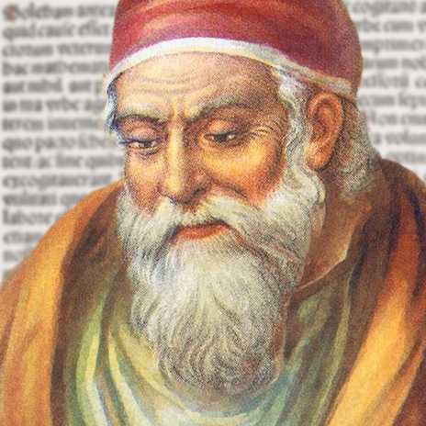
Factoring algorithms
gcd(m, n)
{
while(n != 0)
{
remainder = m mod n
m = n
n = remainder
}
return m
}
O(log N)
Notes:
The greatest common divisor is the largest integer that divides both integers m and n.
Works by computing the remainder until the remainder = 0. The last non-zero remainder is the ‘gcd’.
If m = 1989 and n = 1590, 1st remainder = 399, then 393, 6, 3, and finally 0. So gcd(1989, 1590) = 3.
Source: Data Structures and Algorithm Analysis in C++ (pg. 60)
Efficient for very large n (128,000 digits) in just a few seconds on a laptop!

Slide 9
Factoring Algorithms
def factor(n):
factors = []
for i in range(1, n + 1):
if n % i == 0:
factors.append(i)
return factors
Brute force
Can factor a 10-digit number, but not an 11-digit number on my laptop. (2019)
Even the fastest supercomputer cannot factor a 500-digit number.
Q: How many digits is a 1,024-bit number?
Notes:
Q: What is the Big-Oh expected runtime for this algorithm?
A: O(N)
A: 309 digits long.

Slide 10
Classic Computer v. Quantum Computer
Classic Computer
Fundamental unit: bit
Transistors
Logic gates (AND, OR, etc.)
Limiting factor: heat dispersion
Quantum Computer
Fundamental unit: qubit
Entangled photons
H-Gates
Limiting factor: entangled photons

Slide 11
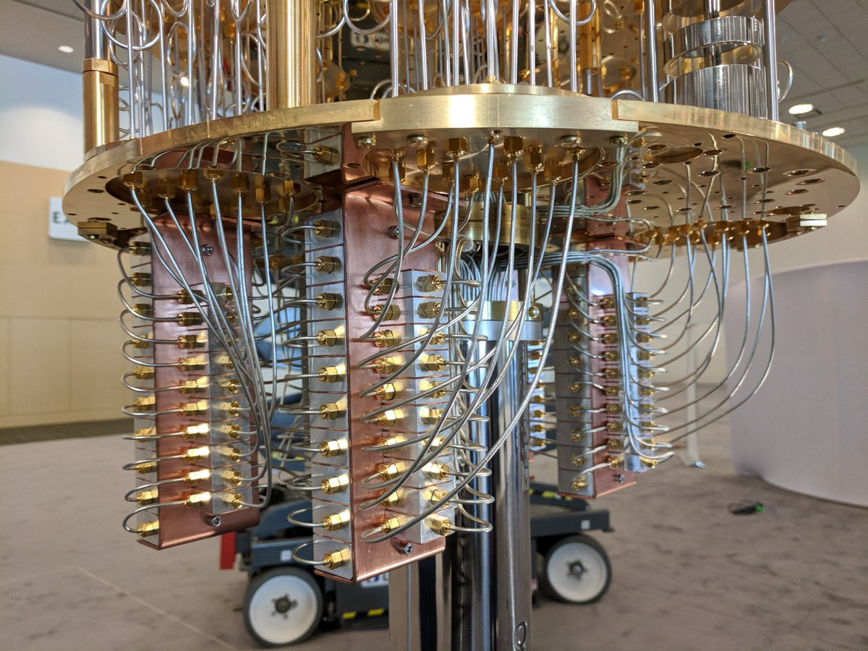
Representing information
Bit 4 | Bit 3 | Bit 2 | Bit 1 | Decimal
0 | 0 | 0 | 0 | 0
0 | 0 | 0 | 1 | 1
0 | 0 | 1 | 0 | 2
.. | .. | .. | .. | ..
1 | 1 | 1 | 0 | 14
1 | 1 | 1 | 1 | 15
Qubit 4 | Qubit 3 | Qubit 2 | Qubit 1 | Decimal
P(0, 1) | P(0, 1) | P(0,1) | P(0,1) | 0-15
Notes:
50-qubit quantum computer (IBM)
Bits carry a positive charge (1) or no charge (0). Each bit must be turned on or off to represent ONE number.
Qubits are in a superposition (both 0 and 1 at the same time), therefore, all 15 numbers can be represented by 4 qubits, v. 64 bits.
Quantum computers are a reduction of both time and space complexity and allow for inherent parallel processing.

Slide 12
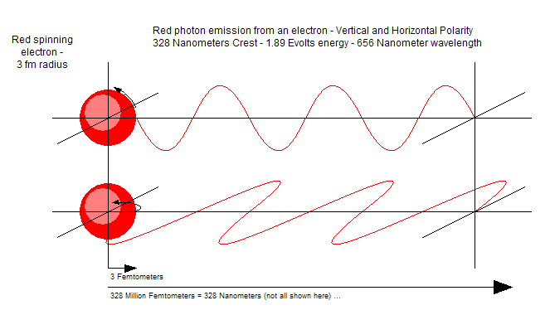
Qubits
Electrons have spin (clockwise or counter-clockwise)
Photons have polarity (horizonal or vertical)
Binary potentials = 0 or 1
A superstate occurs when a particle has to potential of being either, each with an associated probability
Measuring the state of a superposition causes an interaction with its environment and results in decoherence*
Notes:
Explain experiment w/ light and screen, then 1, 2, and finally 3 polarized filters. (horizontal = ½ light, vertical = no light, but inserting a third between the two at 45 degrees = maximal light.). So photons cannot be merely particles to be sieved by the filters! Also acts like a wave. Modern version of Thomas Young’s double-slit experiment with light in 1801 (long before quantum theory!).
Heisenberg’s Uncertainty Principle; cannot know both position and momentum of an electron, because measuring it adds energy and changes the value!
(This is a fundamental problem and destroy’s Laplace’s theory of a deterministic world.). -- S. Hawking
* You will see this in the last Shor’s algorithm video.

Slide 13
Shor’s algorithm
Factoring large numbers on a classical computer is exponential
Factoring large numbers on a quantum computer is log n (polynomial!)
Discovery of Shor’s algorithm drove physical experimentation with quantum computers

Slide 14
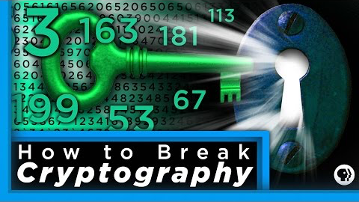
Periods
Power (a) | Period (a mod n) e.g. a mod 10
2¹ = 2 | 2
2² = 4 | 4
2³ = 8 | 8
2⁴ = 16 | 6
2⁵ = 32 | 2
2⁶ = 64 | 4
2⁷ = 128 | 8
2⁸ = 256 | 6
Notes:
Just need to know what a period is to understand the math in the video on the next slide.
Most of the math in this video is review, then gets tricky, so it is better for students to watch it on their own after.

Slide 15
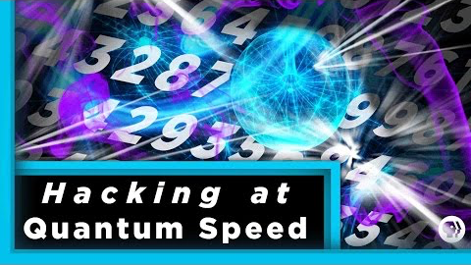

Slide 16
Bibliography
Introduction to the Theory of Computation, Sipser (2006)
Data Structures and Algorithm Analysis in C++, Weiss (2006)
Strategic Infrastructure Security, Peterson (2007)
Introduction to Algorithms, Cormen et al. (2009)
30-Second Quantum Theory, Clegg (2017)
A Brief History of Time, Hawking (2017)
Quantum Computing: A Gentle Introduction, Rieffel and Polak (2011)
Quantum Computing and Shor’s Algorithm, Hayward (1999/2015)

